Slide 1
Adventure Works
SALES ANALYSIS
Dashboard Insights & Strategic Recommendations

Slide 2
Executive SUMMARY
Key Highlights:
  Total Sales: ₹29.36M
  Total Orders: 60.4K
  Total Profit: ₹12.08M
  Peak Sales Month: December (₹3.21M)
  Best Performing Region: Australia (₹9.06M)
  Top Product: Mountain-200 Black, 46 (₹1.37M)
  Top Customer: Nichole Nara (₹13.3K)
Adventure Works shows strong seasonal sales patterns, with Q4 contributing the highest revenue. Australia leads regional performance, and premium bike models dominate product sales.

Slide 3
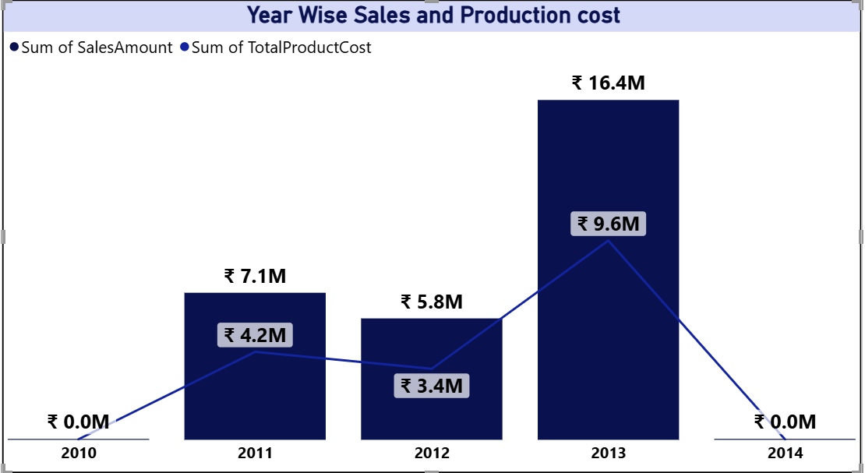
📊 YEAR WISE SALES & COST ANALYSIS
Sales peaked in 2013 at ₹16.4M, followed by a sharp drop in 2014.
Production costs followed a similar trend, peaking in 2013 at ₹9.6M.
2010 and 2014 show negligible sales and cost activity.
2013 was a high-growth year, possibly due to product launches or market expansion. The drop in 2014 may indicate operational shifts, data gaps, or strategic pivots.

Slide 4
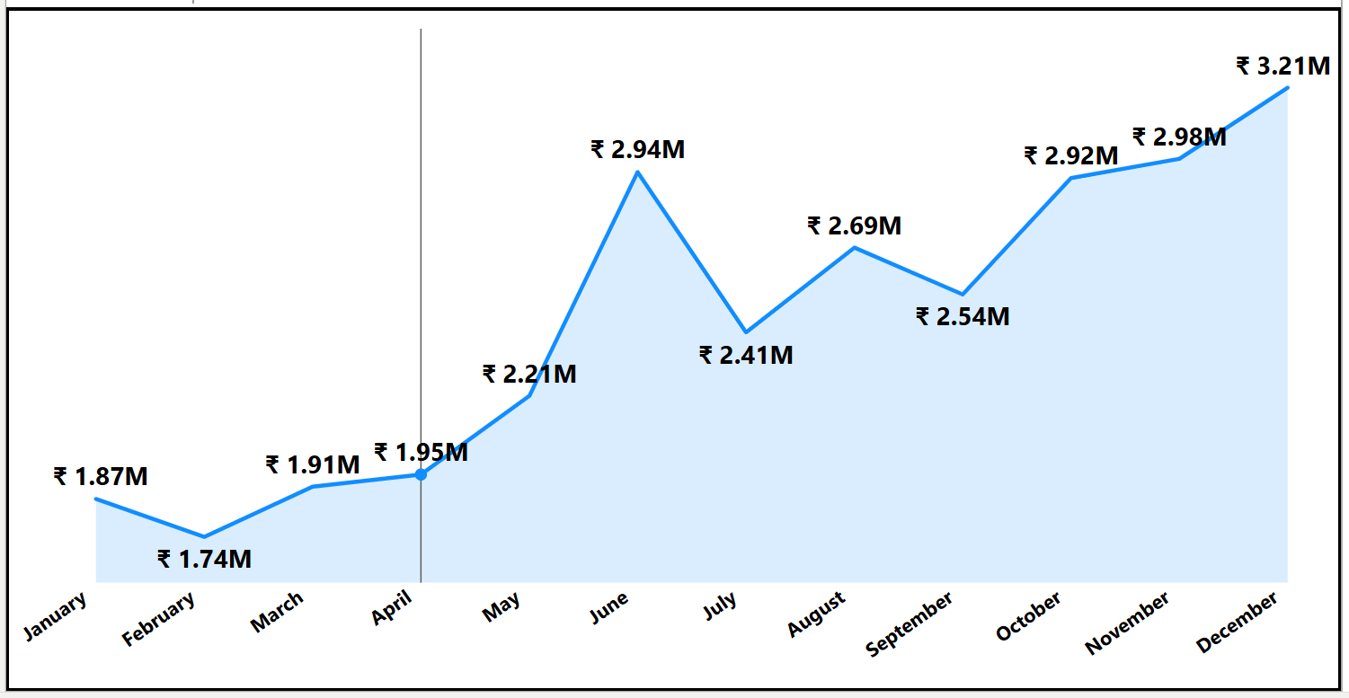
📅 MONTH WISE SALES TRENDS
Sales gradually increase from January to December.
Q4 (Oct–Dec) contributes ₹9.11M, the highest among all quarters.
Strong year-end performance suggests seasonal demand, likely driven by holiday promotions or fiscal year end buying behavior.

Slide 5
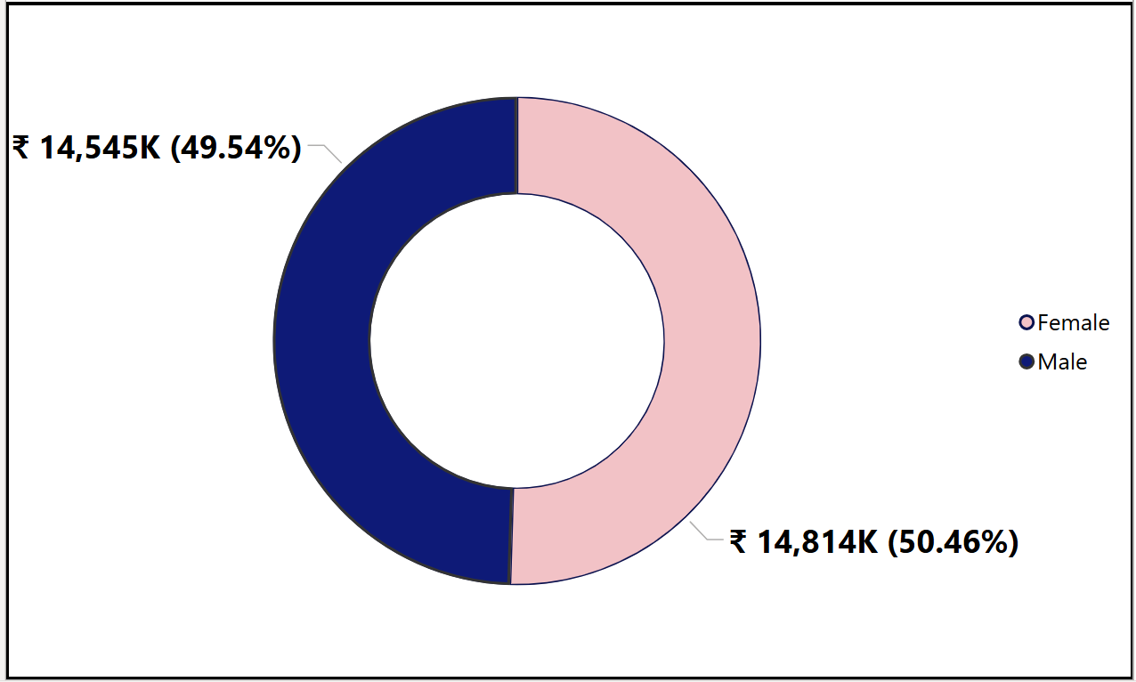
🧍‍♀️🧍‍♂️ CUSTOMER & GENDER INSIGHTS
Top 10 customers each contribute ~₹13K in sales.
Sales are nearly balanced across genders: Female ₹14.81M vs Male ₹14.54M.
Customer loyalty is strong amongst top buyers. Gender-neutral marketing may be effective, as both segments show equal purchasing power.

Slide 6
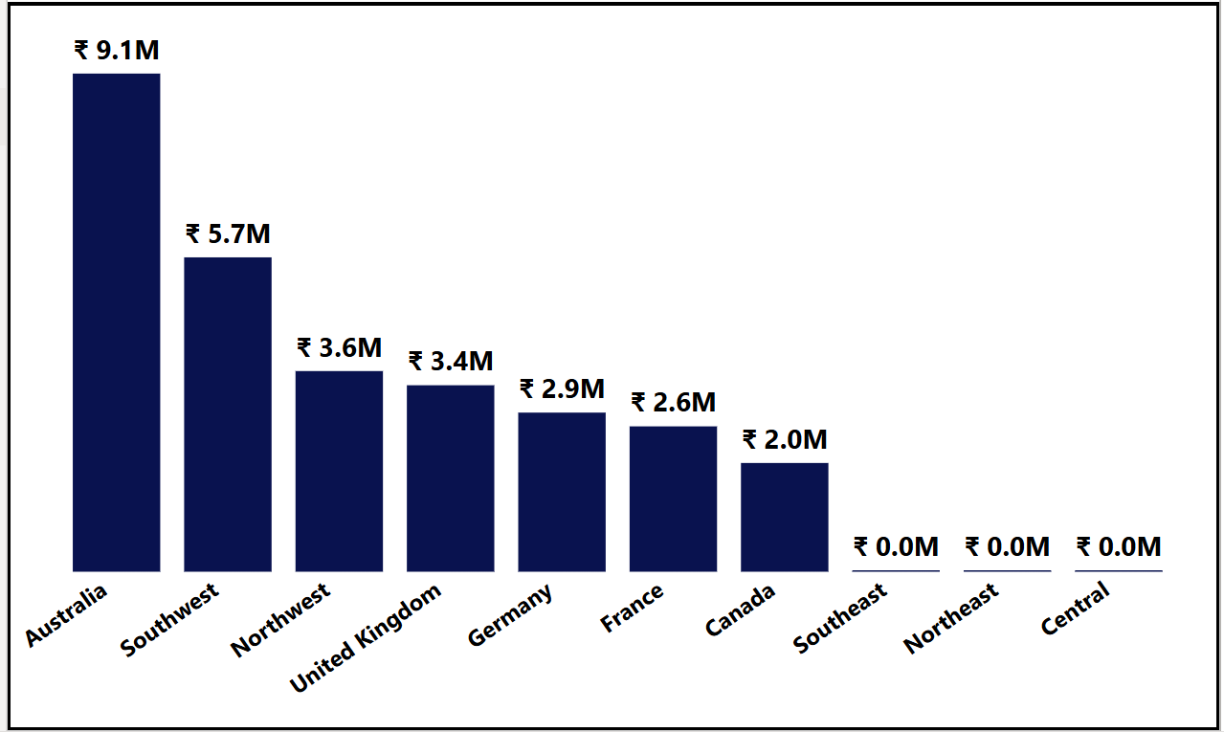
🌍 Regional performance
Australia leads with ₹9.06M in sales.
Canada and Central regions follow, while Southeast, Northeast, and others show minimal activity.
Australia is a mature market. Underperforming regions may need targeted campaigns or better distribution strategies.

Slide 7
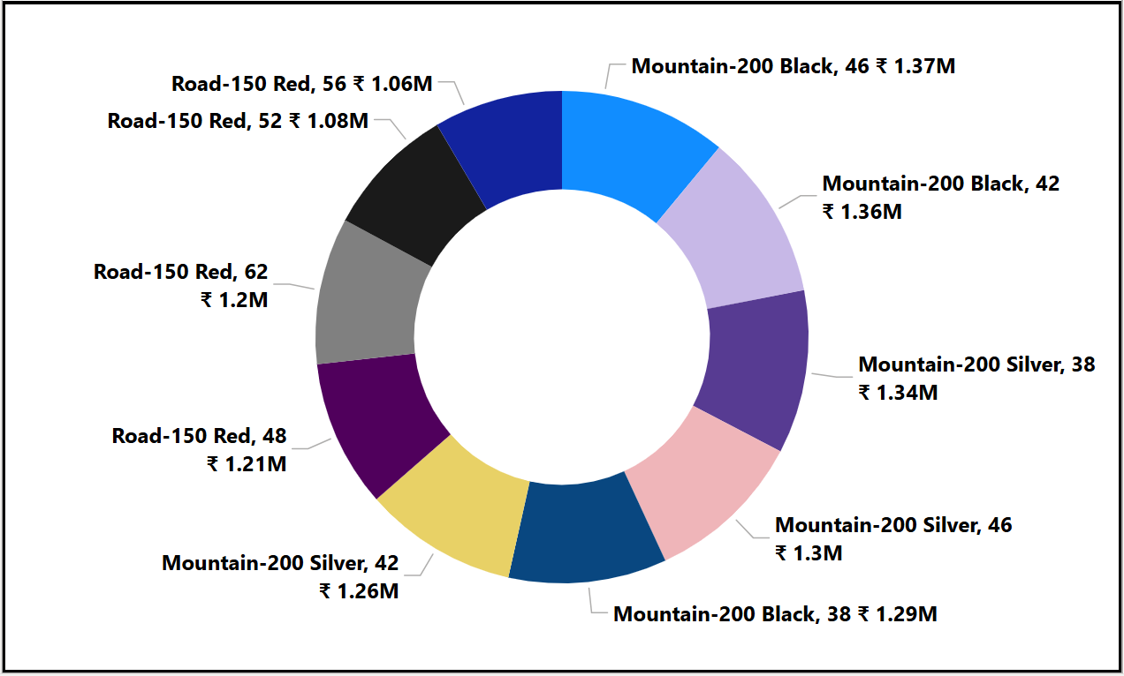
🚴 PRODUCT PERFORMANCE
Mountain and Road bikes dominate top 10 product sales.
Mountain-200 Black and Silver variants consistently outperform.
High-end bikes are the revenue drivers. Inventory and marketing should prioritize these SKUs.

Slide 8
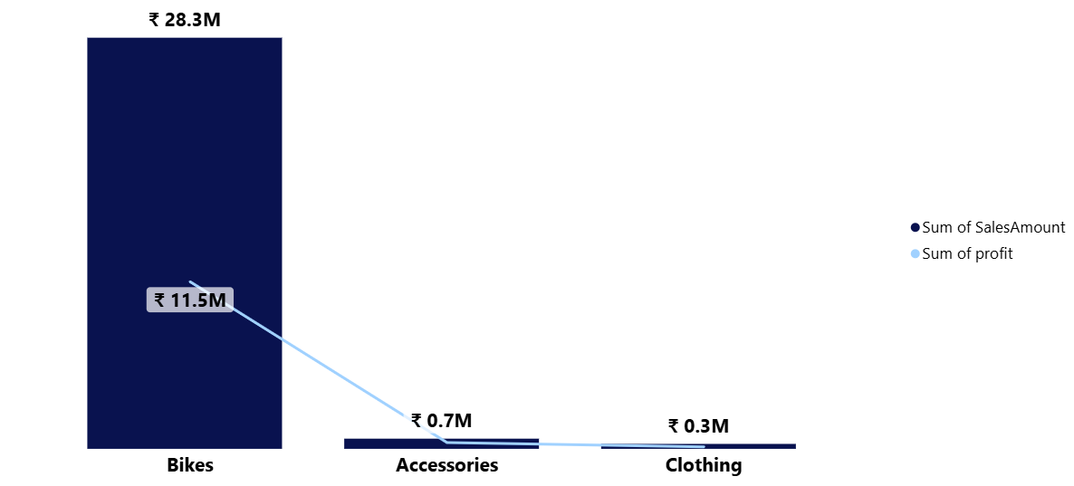
🧮 Category wise sales & profit
Bikes category leads in both sales and profit.
Accessories and Clothing show lower margins.
Focus on high-margin categories like Bikes. Accessories may serve as upsell opportunities but need cost optimization.

Slide 9
🎯Strategic recommendations
📦 Product Strategy -
  Prioritize Mountain-200 and Road-150 series in inventory planning.
  Introduce bundled offers with accessories to boost cross-category sales.
🌍 Regional Expansion -
  Deepen presence in Australia with loyalty programs.
  Investigate low-performing regions for market potential or operational barriers.
💬 Customer Engagement -
  Launch targeted campaigns for top customers to increase repeat purchases.
  Use gender-balanced messaging to maintain broad appeal.

Slide 10
🎁 Seasonal Promotions -
  Capitalize on Q4 momentum with early-bird holiday deals and flash sales.
  Consider off-season campaigns to smoothen monthly revenue dips.
📊 Data Quality & Continuity -
  Address missing data in 2010 and 2014 to ensure complete trend analysis.
  Implement consistent data capture across years for better forecasting.

Slide 11
THANK YOU

